Slide 1
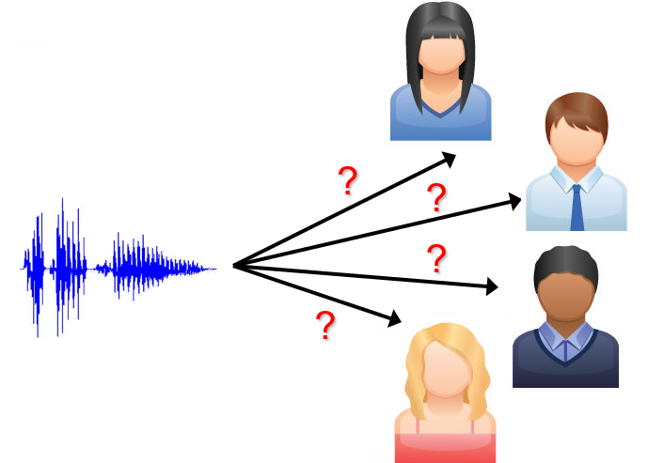
Speaker Verification using Machine and Deep Learning Approaches
on the VoxCeleb Dataset
Yixiong Chen, Zuojun Zhou, Susan Wang, Yuhao Zheng
Dec. 6th, 2024
Notes:
Visual: Diagram of a speaker verification pipeline.

Slide 2
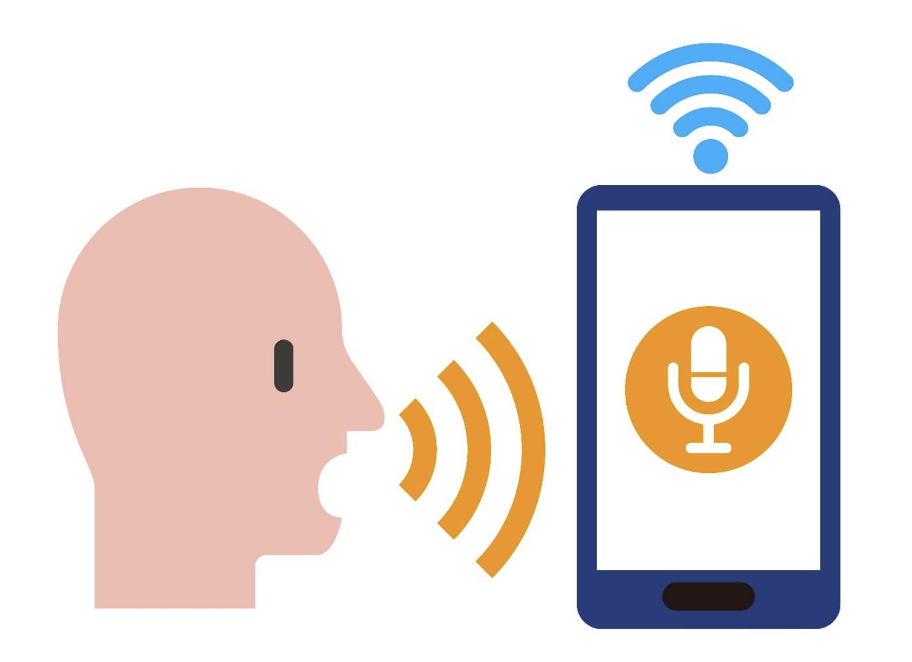
Introduction
Speak Verification:
recognize who is speaking from a clip of audio recordings accurately.
Importance:
Device unlocking, Touchless control, create personalization, etc.
huge real-world usage with a focus on security and usability.

Slide 3
Project Goal
Build >1 models that can accurately recognize who is speaking from audio recordings
compare the performance of Machine Learning and Deep Learning approaches on the in different situations

Slide 4
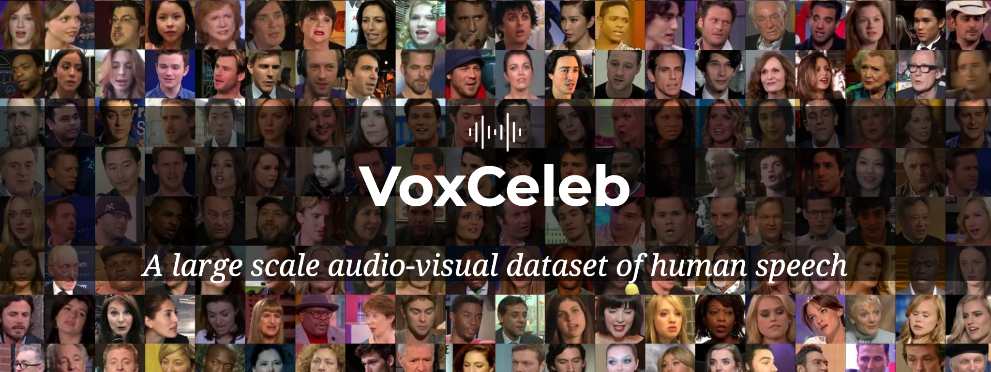
Dataset Overview: VoxCeleb

Slide 5
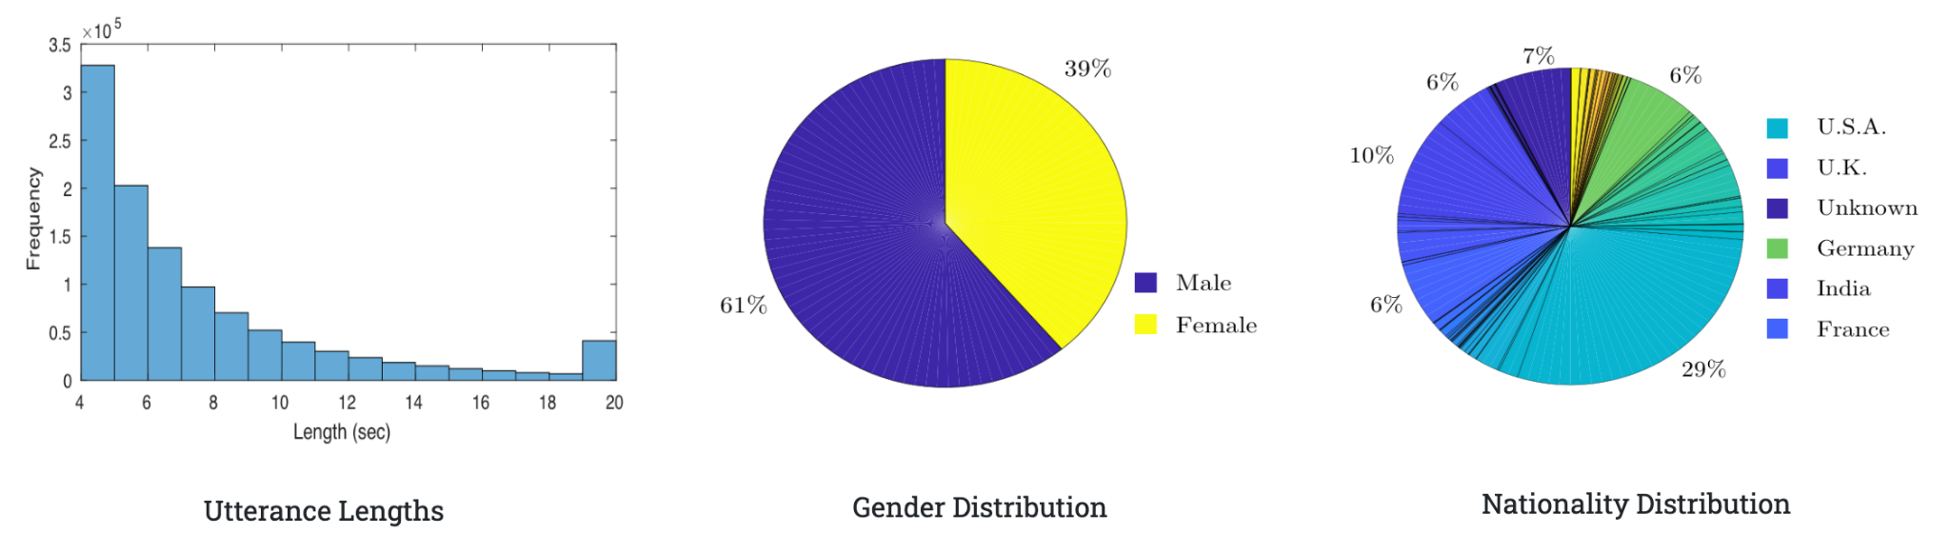
Dataset Overview
Key Features:
Diversity and scale
Real-world noises and variability
Opportunity for preprocessing and augmentation

Slide 6
Data Preprocessing
Normalization
resample to 16 kHz
maintain uniform time resolution
trimmed to remove silence and background noise
focus on speech segments
Augmentation
time masking, pitch shifting, noise addition
increase robustness to real-world variability
Notes:
To prepare the dataset for modeling

Slide 7
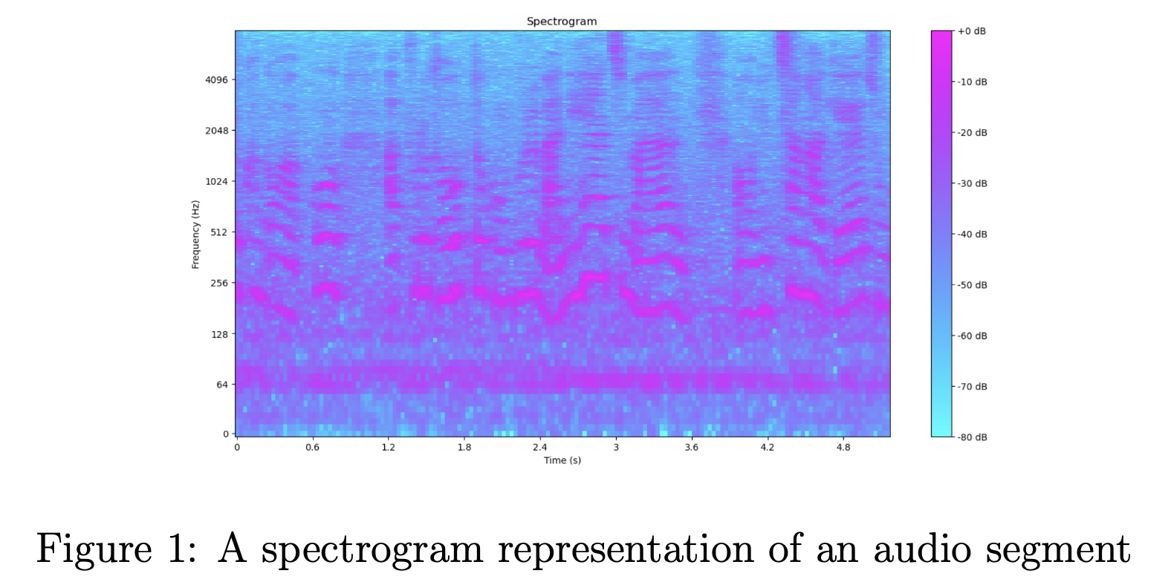
Feature Extraction
For traditional ML models:
Pitch: Mean and standard deviation of fundamental frequency (f0)
MFCCs: 13 Mel-Frequency Cepstral coefficients and their deltas.
Spectral Features: Centroid, contrast, and chroma.
Energy, Zero-Crossing Rate (ZCR): Capture signal dynamics.
Notes:
For segments considered valid, we extracted a range of traditional audio features
Figure 1 illustrates why spectral features are valuable:
- Highlighting feature extraction from frequency bands.

Slide 8

Feature Extraction
For DL models:
Direct use of raw audio or log-Mel spectrograms.
Notes:
These approaches allowed the models to learn features automatically without manual feature engineering.

Slide 9
Methodology: ML Models
Support Vector Machines (SVM):
Kernels: Linear, RBF.
Tuned Parameters using grid search: C (regularization), γ (kernel coefficient).
Random Forest:
Decision trees optimized for depth and estimators.
XGBoost:
Advanced tree-based model
Notes:
Tradition ML models, such as …, were trained on the extracted features.

Slide 10
Methodology: DL Models
Three Multilayer Perceptron (MLP) Architectures:
SmallNet, MediumNet, LargeNet.
trained from scratch using extracted embeddings.
Pre-trained Models (on 200-speaker subset):
Wav2Vec: Fine-tuned for speaker classification.
YAMNet: Adapted from sound event detection to speaker tasks.

Slide 11
Evaluation Metrics
Accuracy:
% of correctly classified samples.
Primary metric for comparison.
Training Time:
Qualitative assessment of computational overhead.
We balances clarity in comparisons and real-world feasibility.

Slide 12
Experiment Setup
Dataset: VoxCeleb (200-speaker subset used for consistency).
Data split: 80% training, 20% testing (no speaker overlap).
Inputs:
ML: Hand-crafted features (e.g., MFCCs, ZCR).
DL: Raw audio or spectrograms.
Baseline vs. fine-tuned models tested.

Slide 13
Machine Learning Results
Baseline Performance
Naive Bayes: 24.15%
Logistic Regression: 36.41%
Support Vector Machine (SVM): 37.61%
Random Forest: 33.83%
Hyperparameter Optimization
Optimized XGBoost achieved 35.35% accuracy
Key tuned parameters:
Learning rate: 0.05
Max depth: 10
Estimators: 1000
Subsample: 0.4

Slide 14
Deep Learning Results
MLP Models
SmallNet: 69.94% training, 20.91% validation accuracy
MediumNet: 63.83% training, 20.48% validation accuracy
LargeNet: 78.49% training, 20.52% validation accuracy
Fine-Tuned Models
HuBERT: Not fine-tuned; high computational cost.
Wav2Vec:
Training: 84.92%; Validation: 60.03%.
YAMNet:
Training: 74.09%; Validation: 18.99%.
Shows potential; needs further optimization.

Slide 15
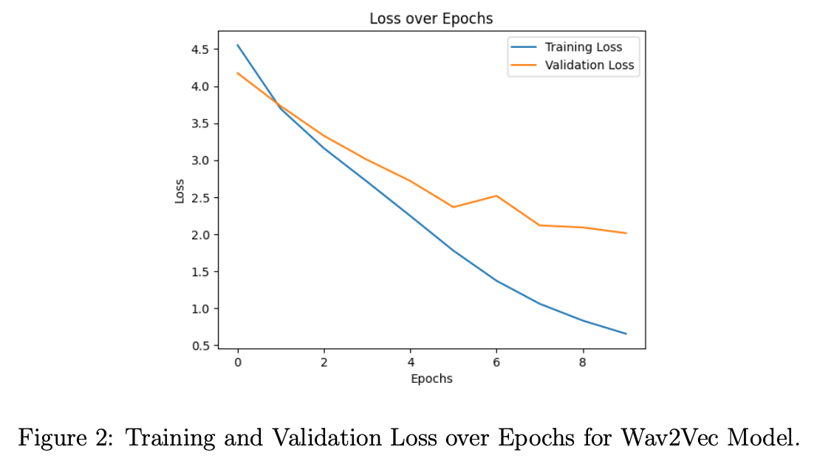
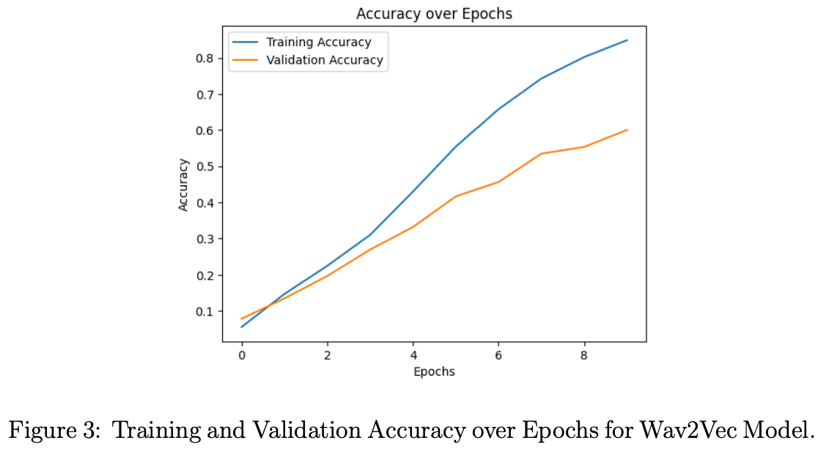
Deep Learning Results

Slide 16
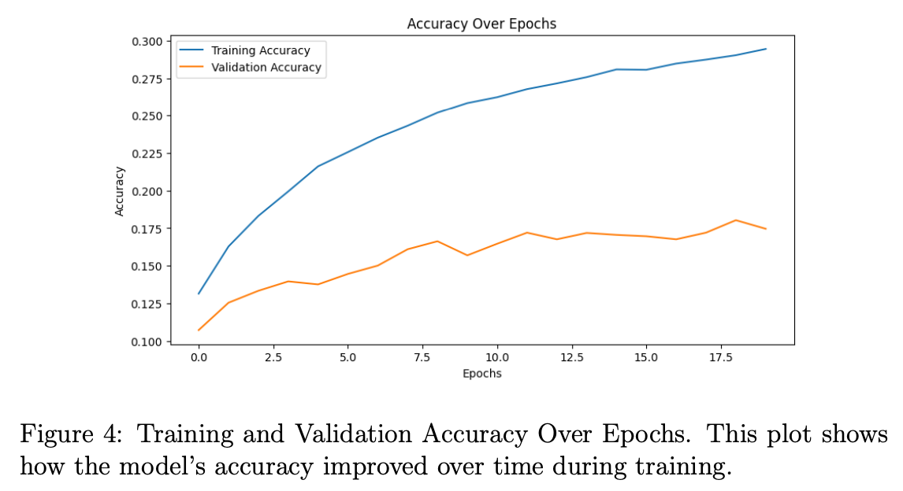
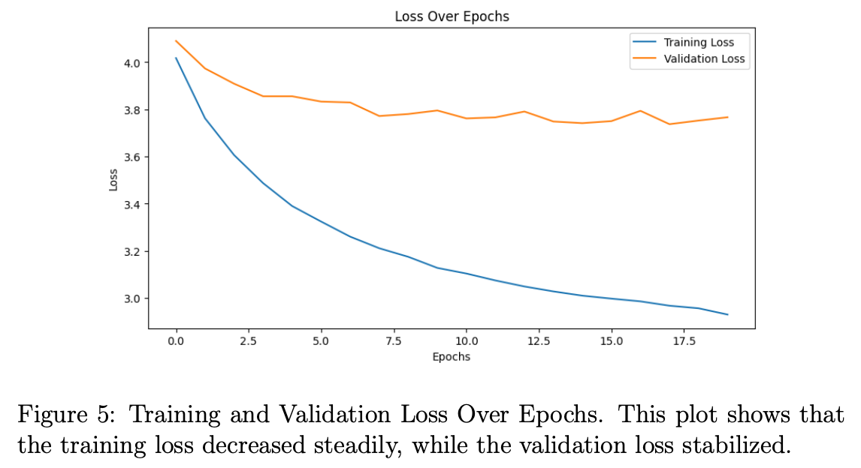
Deep Learning Results

Slide 17
Key Findings
ML vs. DL:
ML: Faster training, simpler, but lower accuracy.
DL models, especially Wav2Vec, excel at speaker verification.
DL: Higher accuracy, computationally intensive.
XGBoost: Best ML model but lags behind DL.
Notes:
Visual: A trade-off graph between accuracy and computational cost.

Slide 18
Discussions
Accuracy vs. Resource Efficiency:
DL models excel in complex, large-scale tasks.
ML methods suitable for constrained hardware or rapid prototyping.
Hybrid Approaches:
Combine DL embeddings with ML classifiers.
Pre-trained Model Optimization:
Techniques like pruning, quantization to reduce computational demands.
Notes:
Visual: A trade-off graph between accuracy and computational cost.

Slide 19
Conclusion, Future Work
DL models (Wav2Vec) significantly outperform ML in speaker verification.
ML remains viable for lightweight applications.
Future Directions:
Efficient DL methods for resource-limited environments.
Enhanced pre-training for speaker-specific tasks.
Hybrid models balancing accuracy and cost.
Notes:
Visual: A roadmap or flowchart for future directions.

Slide 20
References
[1] McFee, B., et al. ”librosa: Audio and music signal analysis in python.” Proceedings of the 14th Python in Science Conference. 2015.
[2] Chen, T., and Guestrin, C. ”XGBoost: A scalable tree boosting system.” Proceedings of the 22nd ACM SIGKDD International Conference on Knowledge Discovery and Data Mining. 2016.
[3] Schneider, S., Baevski, A., Collobert, R., Auli, M. (2019). ”Wav2vec: Unsupervised pre-training for speech recognition.” In Advances in Neural Information Processing Systems (pp. 8012-8022).
[4] Hsu, W.-N., Heigold, G., Bollegala, D., Chen, J., Eisenschlos, J., Raffel, C., Auli, M. (2021). ”HuBERT: Self-Supervised Speech Representation Learning by Masked Prediction of Hidden Units.” arXiv preprint
arXiv:2106.07447.
[5] Campbell, N., Klatt, D., Bergstra, J., Bergstra, S. (2020). ”YAM-Net: A Pretrained Audio Event Classification Model and Dataset.” arXivpreprint arXiv:2009.03029.
[6] Praat Developers. ”pyin: Pitch tracking.” https://librosa.org/doc/main/generated/librosa.pyin.html
[7] Loshchilov, I., Hutter, F. (2017). ”Decoupled Weight Decay Regularization.” arXiv preprint arXiv:1711.05101.
[8] TensorFlow Hub Team. ”TensorFlow Hub.” https://www.tensorflow.org/hub.

Slide 21
Thank You!
Any Questions?

